Slide 1
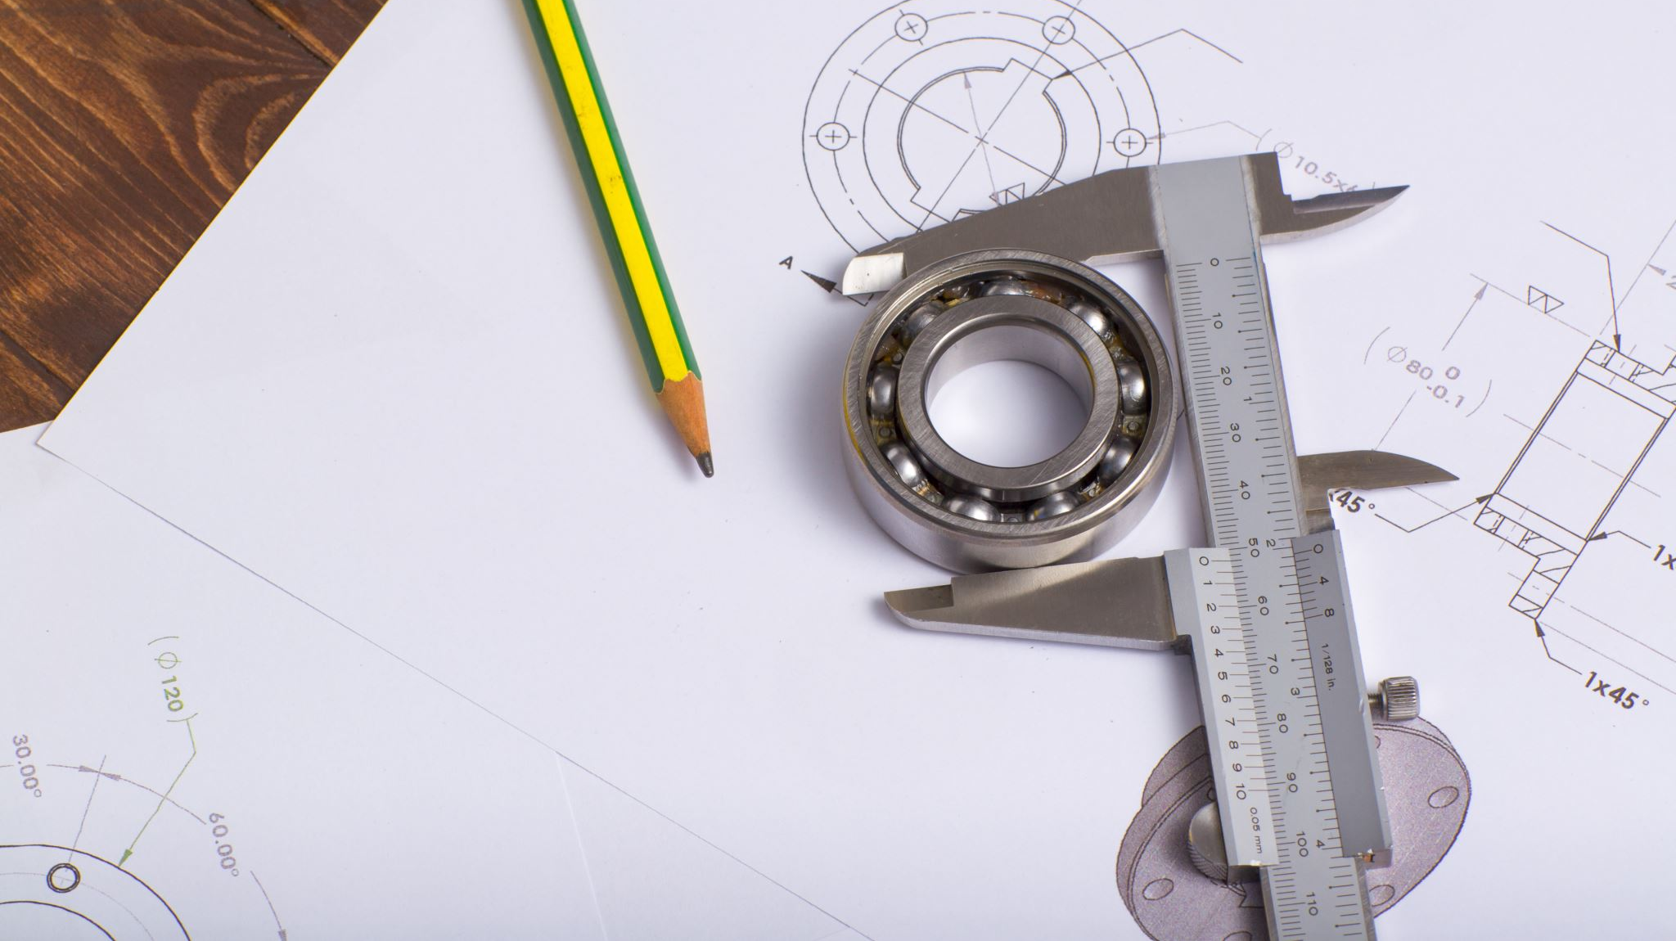
Sketching
Unit 5

Slide 2
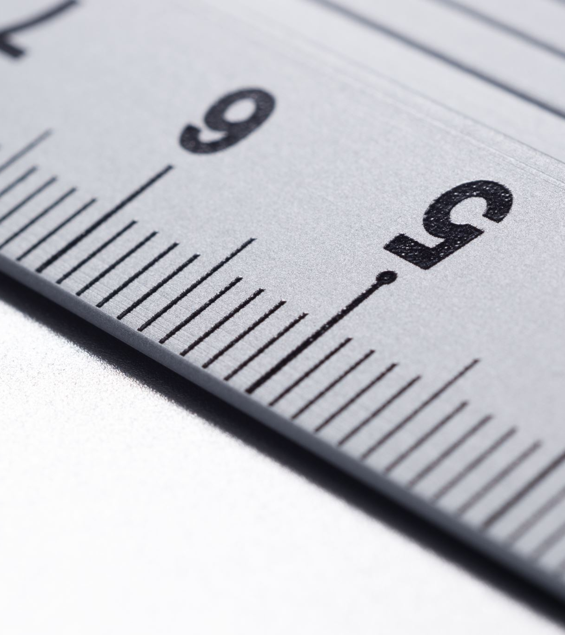
Sketching Orthographic Views
Using a ruler and the shape handout, measure the object’s width, height, and depth
Using graph paper, a pencil and a ruler, draw the front, top and side of each shape

Slide 3
Practice Together
Notes:
Use the following handout
L BLOCK.pdf

Slide 4
Practice Together
Notes:
Use the following handout
L BLOCK.pdf

Slide 5
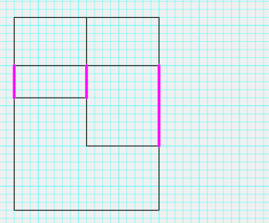
Practice Together
Start with the Front View
Draw a line for each measurement
Then draw the Top
Use a ruler to project the edges of the Front to match the same width
Notes:
It might be helpful to make a small point at the lower left of the shape, measure out the bottom length of the Front, make another small point, then connect the points with the ruler, rather than holding the ruler, trying to read it and draw a straight line.
Use the ruler the create a straight edge to project the width of the front up to the top view, rather than having to measure it out again.
You would not need to draw in the projection lines, or you can lightly draw them in and erase later. The Magenta Construction/Projection lines are there to show how the width measurement is the same for the top view.

Slide 6
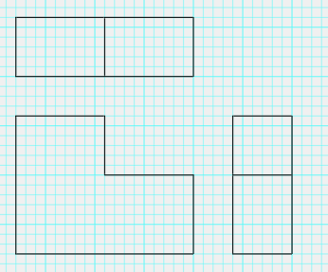
Practice Together
Next draw the Side
Use a ruler to project the edges of the Front to match the same height
TOP
FRONT
SIDE
Notes:
Use the ruler to project the object’s height over to the side view. The magenta construction/projection lines indicate how the height aligns from front to side view.

Slide 7
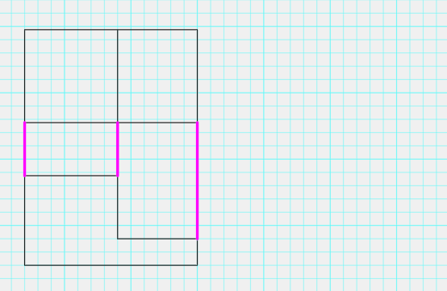
Example A
Notes:
Use A-B.pdf

Slide 8
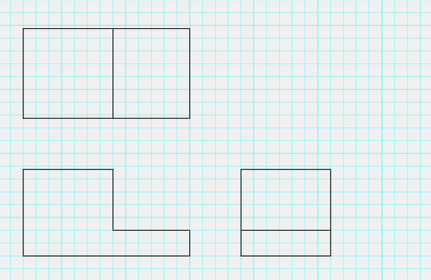
Example A
TOP
FRONT
SIDE
Notes:
Use A-B.pdf

Slide 9
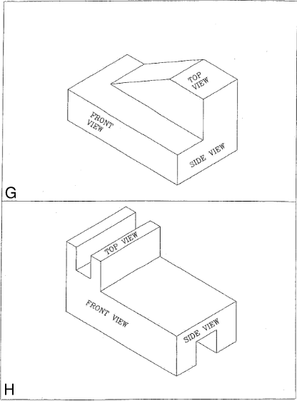
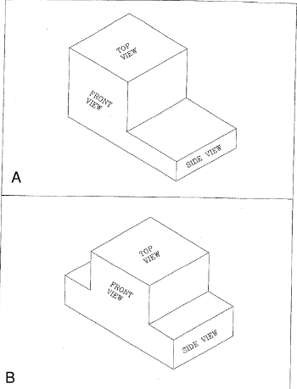
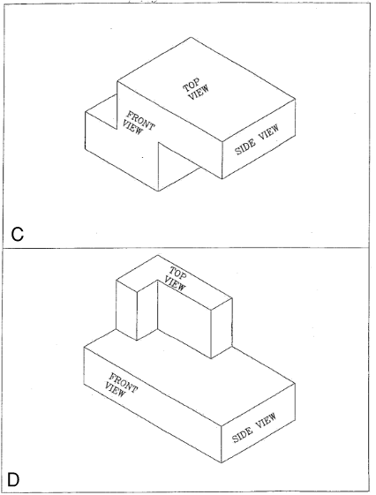
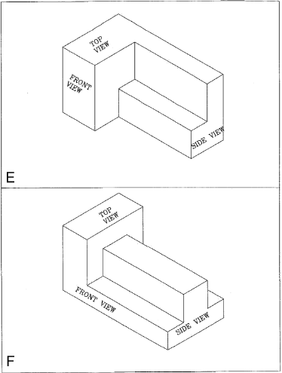
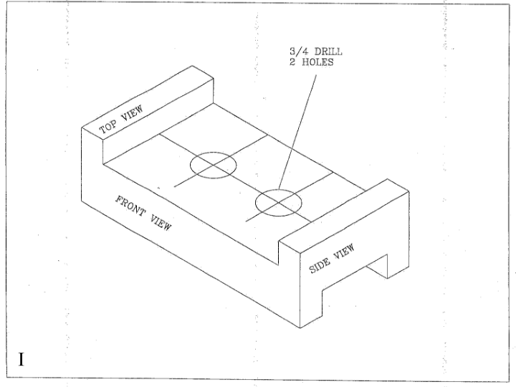
Apply it! Complete measuring and sketching the remaining shapes
Notes:
Use the following handouts. May want to give one handout at a time then check the student work when completed before moving on to the next handout.
C-D.pdf
E-F.pdf
G-H.pdf
I.pdf

